Slide 1
Investigating Potential Data Structures for NVRAM
Wenlong Wang
CSCI 5980 University of Minnesota

Slide 2
Non-Volatile Memory (NVRAM)
Non-volatile
Special mechanism to ensure data consistency
Eg. Some needs to be written twice
Asymmetric read/write performance
Write speed is much worse than read
Byte-addressability
Low power consumption
Notes:
Reference: http://image.baidu.com/search/detail?ct=503316480&z=undefined&tn=baiduimagedetail&ipn=d&word=NVRAM&step_word=&ie=utf-8&in=&cl=2&lm=-1&st=undefined&hd=undefined&latest=undefined&copyright=undefined&cs=1462414080,2229019000&os=3295507999,1389790644&simid=3300312380,42660294&pn=0&rn=1&di=40920&ln=394&fr=&fmq=1587973683026_R&fm=&ic=undefined&s=undefined&se=&sme=&tab=0&width=undefined&height=undefined&face=undefined&is=0,0&istype=0&ist=&jit=&bdtype=0&spn=0&pi=0&gsm=0&objurl=http%3A%2F%2Fs13.sinaimg.cn%2Fbmiddle%2F60c6d868x6e1a00bc0e3c%26690&rpstart=0&rpnum=0&adpicid=0&force=undefined

Slide 3
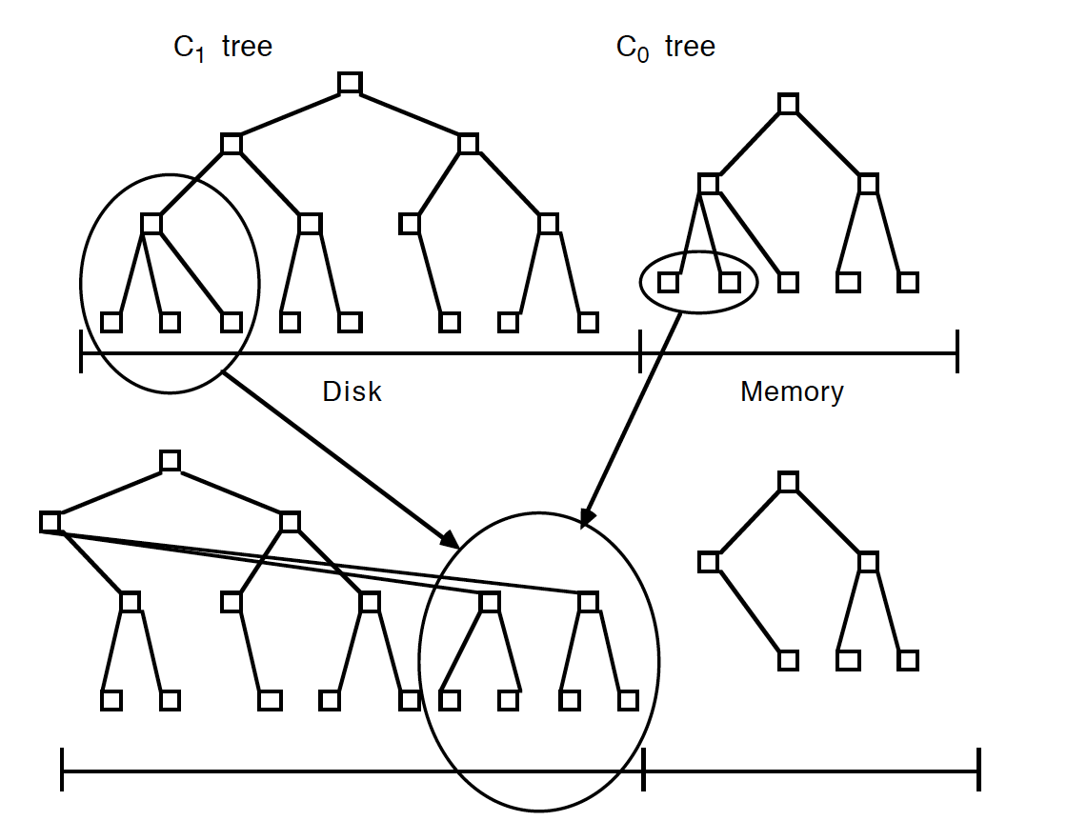
Existing Data Structures for NVM
B+ tree and its varients
Eg. B+ tree, NV-tree
LSM-Tree and its variants
Eg. LevelDB, PebblesDB
Hash table
Notes:
Reference: O'Neil, P.E., Cheng, E., Gawlick, D., & O'Neil, E.J. (2009). The log-structured merge-tree (LSM-tree). Acta Informatica, 33, 351-385.

Slide 4
Existing Data Structures for NVM
B+ tree and its variants
B+ tree:
Equal access time for each data
Increase the number of indexes stored in one node to reduce the height of the tree (compared to B tree)
Shorter the tree is, faster the lookup speed it has
With limited number of tree balancing
B+ tree:
NV-tree: reduce data consistency cost
Notes:
Reference: https://qph.fs.quoracdn.net/main-qimg-c0d8126937da716a0225f66e8c1d9d2f

Slide 5
Existing Data Structures for NVM
LSM-Tree and its variants
LSM-Tree
Combine multiple random write into one sequential write
Small tree merged into larger tree
Sacrifice some read performance to achieve a better write performance
Need compaction from time to time
Notes:
Reference: O'Neil, P.E., Cheng, E., Gawlick, D., & O'Neil, E.J. (2009). The log-structured merge-tree (LSM-tree). Acta Informatica, 33, 351-385.

Slide 6
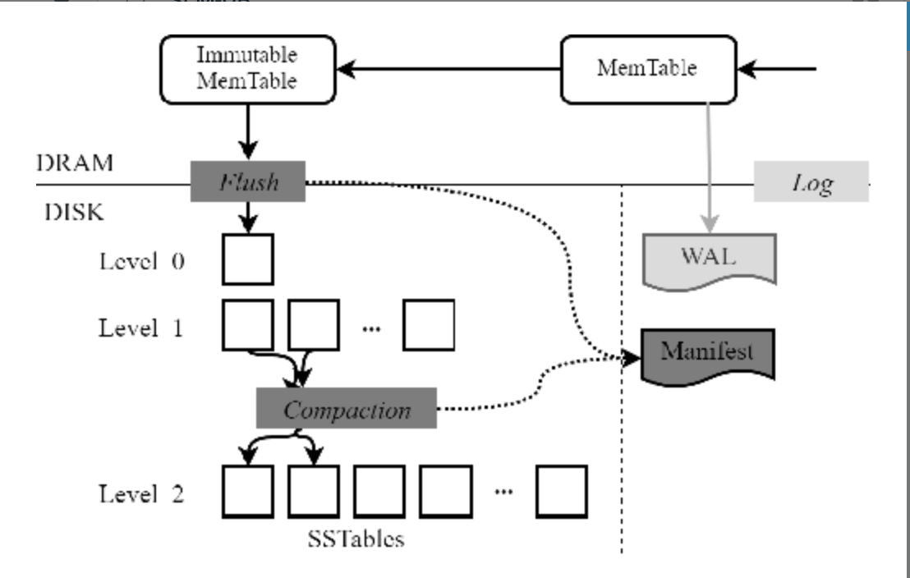
Existing Data Structures for NVM
LSM-Tree and its variants
LevelDB
Leveled structure
Batch the write operations
Still introduce large write amplification in compaction
Notes:
Reference: O'Neil, P.E., Cheng, E., Gawlick, D., & O'Neil, E.J. (2009). The log-structured merge-tree (LSM-tree). Acta Informatica, 33, 351-385.

Slide 7
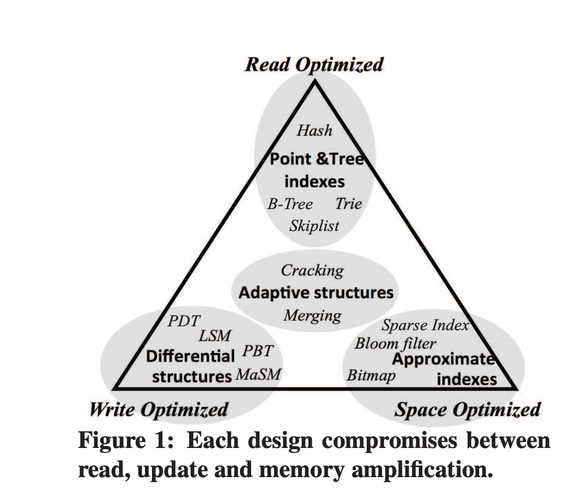
Methods to improve performance
Read performance (close to DRAM)
Write performance (worse than read performance)
Trade-off among read, write and space.
However, some shortcomings could be avoided by the intrinsic of NVM
Notes:
Reference: Idreos, Stratos et al. “The Periodic Table of Data Structures.” IEEE Data Eng. Bull. 41 (2018): 64-75.

Slide 8
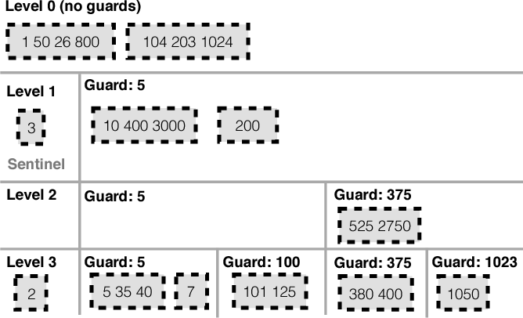
Methods to improve performance
Sorted vs. unsorted node
Keeping data inside each nodes sorted could benefit the read performance
But it requires more overhead when writing a new data
PebblesDB
Put guards in the same level to restrict the compaction size
Skip list
Leverage the byte-addressability to benefit
read performance
… More to explore
Notes:
Reference: Raju, P., Kadekodi, R., Chidambaram, V., & Abraham, I. (2017). PebblesDB: Building Key-Value Stores using Fragmented Log-Structured Merge Trees. SOSP '17.

Slide 9
Thanks!
Notes:
Reference: Götze, Philipp et al. “Data Structure Primitives on Persistent Memory: An Evaluation.” ArXiv abs/2001.02172 (2020): n. pag.

